Slide 1
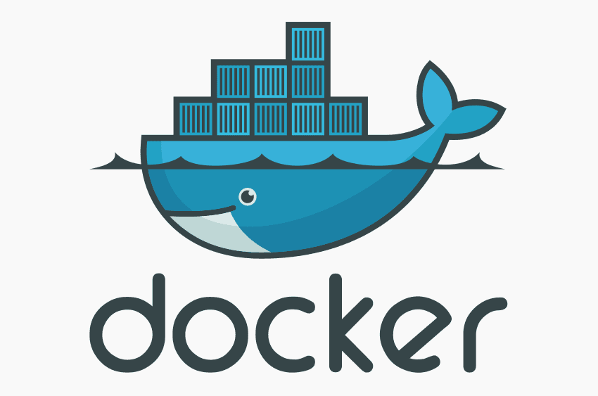
Compilation, Docker & Singularity
11.22.24

Slide 2
Learning Objectives
Why Compile?
Types of Compilation
Containerization
Docker & Singularity

Slide 3
Compilation creates machine-readable code
Main benefit: speed
Compilation requirements are stricter, likely to find potential bugs
More portable: no dependencies
Keeps your source code private

Slide 4
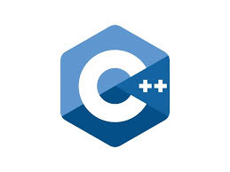

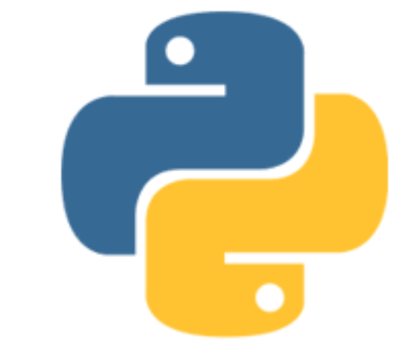
Compiled vs. Interpreted
Only done once
Whole
Program
Compiler
Machine
Code
Performed each time
Cpython
Cpython VM
Line by
Line &
Executes
Bytecode
Interpreter

Slide 5
Compilation Levels: Byte Code
Automatically generated in __pycache__ when you import “import” existing code
Can also generate with “py_compile”
.pyc extension
Negligible effect on performance—it still needs to be interpreted

Slide 6
Compilation Levels: JIT (Numba)
Just-In-Time compiles at runtime
Fully compilation requires knowing the variable types
e.g. inputs are 2 int32 numbers and output is float
This info becomes available when we pass inputs, allowing compilation at run-time
Huge speed-up for certain frequently-called functions

Slide 7
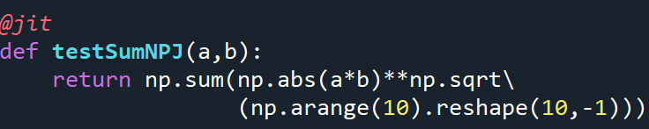

JIT (Numba)
Greatest benefits for loops
Example: compute
$$\sum_{i}{\sum_{j}{{\left|A_{i,j}B_{i,j}\right|}^{\sqrt{j}}}}$$
A,B both 10 x 5000
Highly vectorized code: JIT has less benefit (in this case none)
10,000 calls
with JIT: 8.9s
no JIT: 7.6s

Slide 8
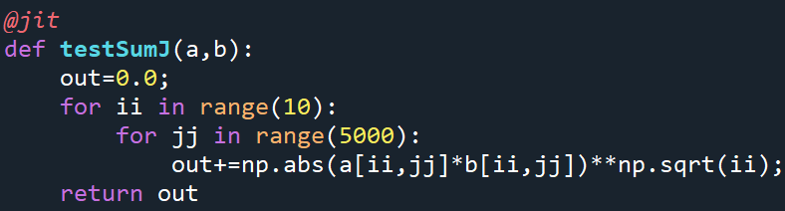

JIT (Numba)
$$\sum_{i}{\sum_{j}{{\left|A_{i,j}B_{i,j}\right|}^{\sqrt{j}}}}$$
Same calculation as a loop:
10,000 calls
with JIT: 6.67s
no JIT: 1147s

Slide 9
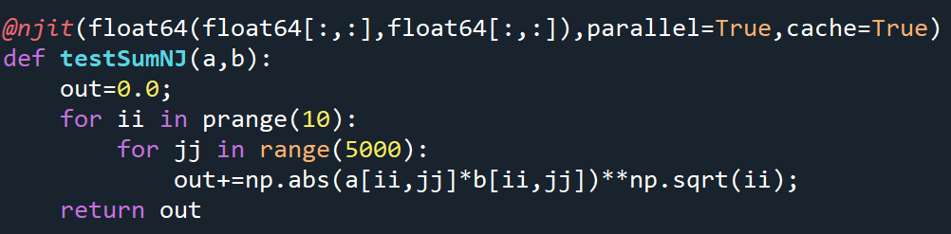
NJIT (Numba)
NJIT allows pre-specified types
Declare a parallel loop using prange instead of range:
Output type: float64
Inputs: two float64 arrays
10,000 calls: 2.2s

Slide 10

Full Compilation: Cython
print(“Hello World”)
#include <stdio.h>
int main() {
printf(“Hello World”)
return 0
}
01001000 01100101 01101100 01101100 01101111 00100001

Slide 11
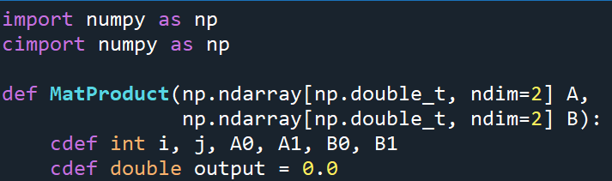
Cython
Import the modules as c (cimport)
Everything must have a declared type
def func(double var1, int var2….):
cdef to declare variables

Slide 12
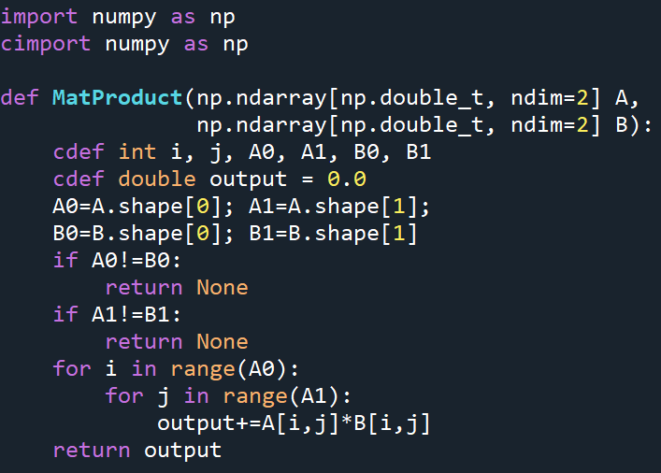
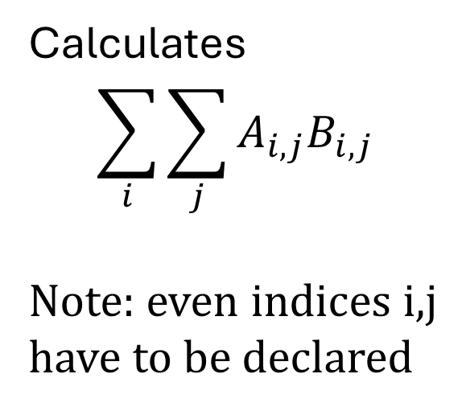
Cython
Calculates
$$\sum_{i}{\sum_{j}{A_{i,j}B_{i,j}}}$$
Note: even indices i,j
have to be declared

Slide 13
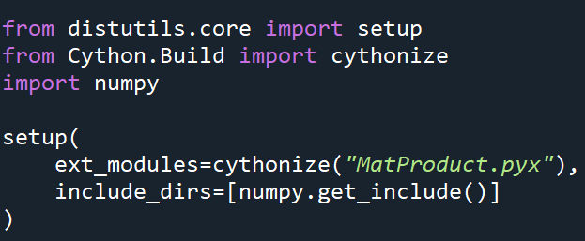
Cython
Save the code as .pyx
You may need to use BASH to set this extension (rename with mv)
Create a Cython setup script

Slide 14

Compile by calling the script
Setup file’s name
Notice the file names indicate OS and CPU architecture

Slide 15
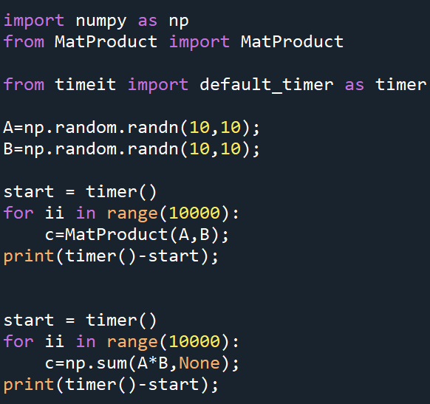
Import with the original name
10x faster than numPy,
but only for small matrices
as I didn’t parallelize

Slide 16
Compilation Take Aways
JIT compilation is low-effort, primarily benefits code with loops or other control-flow
Cython speedups are much larger but take effort. Some libraries (NumPy) are already C, so speedup depends on context, data-size
Another module (PyInstaller) can produce executables (.exe) for stand-alone apps

Slide 17
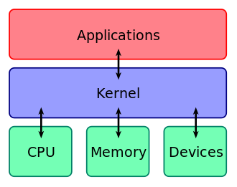
Virtual Machines
VMs simulate another computer
Hardware is partitioned to separate the main computer from 1+ virtual machines
Memory partition is physical (space)
CPU partition may just be access time
Full isolation, high overhead cost

Slide 18
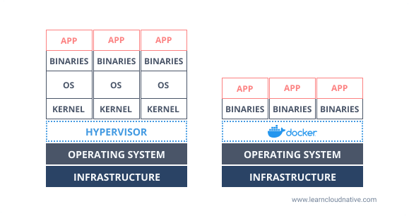
VM vs. Container
Virtual
Machine
Container

Slide 19
Docker vs. Singularity: the difference?
Not much….except:
Docker requires root (superuser) privileges, Singularity does not.
Docker came first but only admins can use on HPC due to privilege requirements
Docker was designed for regular users (bigger community)
Singularity is designed for HPC
Singularity can use docker images

Slide 20
FYI—Apptainer=Singularity
Singularity was renamed “Apptainer” in 2021
There was a schism and Singularity devs split into Apptainer and SingularityCE=Community Edition….
The Campus Cluster redirects /bin/singularity to Apptainer

Slide 21
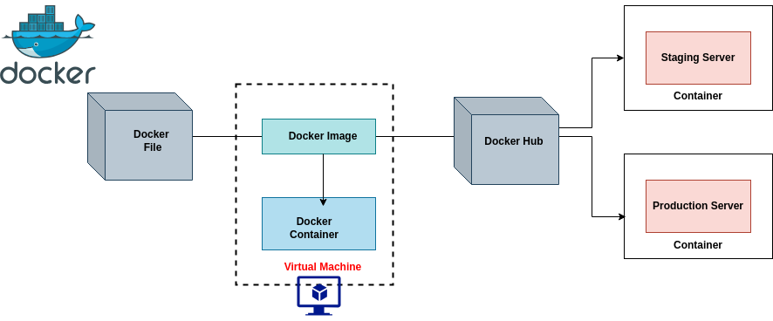
Docker WorkFlow

Slide 22
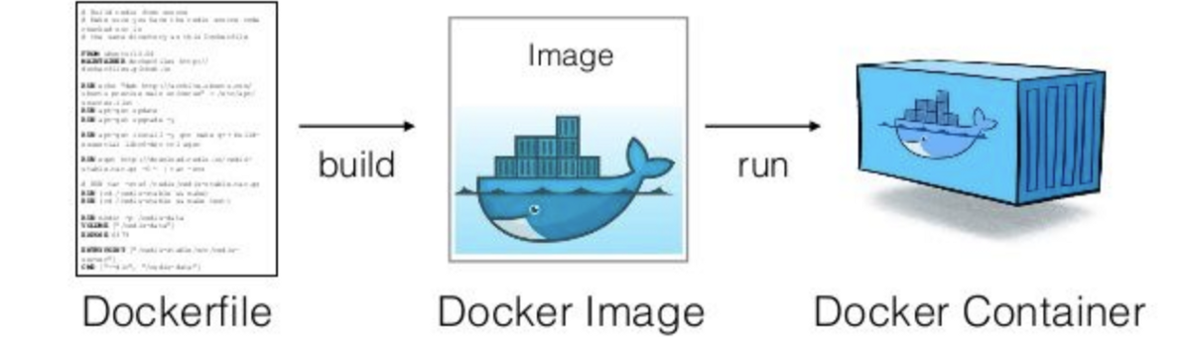
Images vs. Containers
The image is a code environment—this is what you download
You can build your own images (not covered today) or pull from DockerHub

Slide 23
Running Containers (BASH)
Pull containers from DockerHub:
docker pull python
The Python environment has Python+stripped-down LINUX to run it in
Running the image creates a container: you can have multiple containers (instances) of the same image:
docker run -it python
The it flag turns on interactive mode (opens Python shell)

Slide 24
Same Format for Singularity/Apptainer
Singularity and Apptainer can directly pull from DockerHub:
apptainer pull python
File will be pulled as singularity format (SIF) instead of Docker (DEF)
apptainer run -it python

Slide 25
Summary
Containers provide isolated environments
Portable: don’t require external files
not specific to a OS
Isolated: secure & minimal impact on host
Efficient: faster than setting up a separate environment through Virtual Machines

